Slide 1
Managing Data in R - Part 2

Slide 2
Table of Contents - Part 2
1. Cleaning Data
2. Sampling for Modeling and Validation

Slide 3
Factor Variables
Used for categorical data.
Check levels with levels(df$col)
Example:
df$gender <- factor(c('M', 'F', 'F'))

Slide 4
Renaming Columns
Rename using:
colnames(df) <- c('new1','new2')
Or dplyr:
df <- rename(df, newname = oldname)

Slide 5
Filtering Data
Filter rows based on condition:
df[df$Age > 25, ]
Using dplyr:
filter(df, Age > 25)

Slide 6
Sorting and Arranging
Sort with:
df[order(df$col), ]
Using dplyr:
df %>% arrange(col)

Slide 7
Cleaning Data
Trim whitespace: trimws()
Remove NA: na.omit()
Replace: df[df=='?', ] <- NA

Slide 8
Cleaning Data in R
Data cleaning is the process of transforming raw, inconsistent data into a structured format suitable for analysis. It ensures that datasets are free of errors, missing values and inconsistencies that can give incorrect analysis or poor modeling.
The main goals of data cleaning include:
Eliminating errors and redundancy
Ensuring accuracy and completeness
Standardizing formats and types

Slide 9
Characteristics of Clean Data:
Clean data is structured, complete and free from errors or irrelevant values.
No duplicate rows or values
No spelling mistakes or inconsistencies
Correct data types
No unwanted special characters
Outliers handled or understood
Common Signs of Messy Data:
Messy data often requires transformation or correction before use.
Special characters (example., commas in numbers)
Numbers stored as text
Duplicate or missing rows
Spelling inconsistencies
Extra whitespace or zeros instead of nulls

Slide 10
Implementation of Data Cleaning:
1.Importing the Dataset
2. Identify Missing Values
3. Handle Missing Values
4. Summary and Boxplot for Inspection
use summary(airquality) and boxplot(airquality) to spot outliers and missing values.
5. Replace Missing Values with Median/mean
Replace NA values in Ozone and Solar.R with the median of their respective columns.
6. Handling Outliers using IQR method
using the IQR method to detect and cap outliers so they don’t influence the analysis.
7. Visualizing the results
After cleaning we now use the head() and boxplot() to visualise the cleaned dataset to confirm no missing values remain.

Slide 11
Cleaning data
Focuses on fixing issues identified during data exploration/visualization
Two major concerns:
1. Missing values: Common across most datasets
2. Invalid values: Often domain-specific and require context

Slide 12
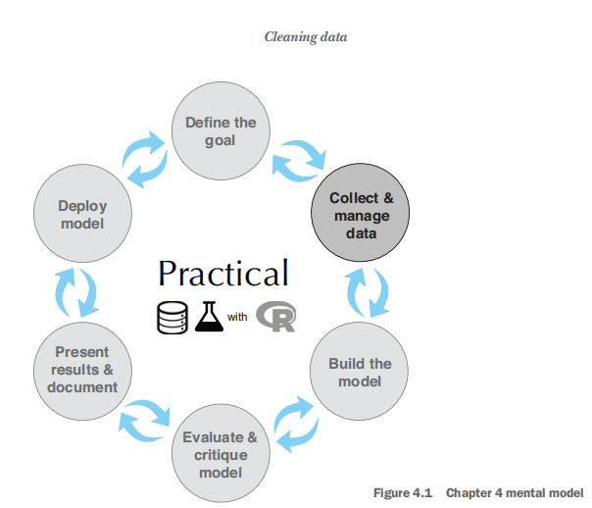

Slide 13
Missing vs. Invalid Values
Missing values:
Handled similarly across different projects
Can be filled, removed, or imputed based on context
Invalid values:
Vary based on domain knowledge
Require understanding of what constitutes "valid" data

Slide 14
Example : Suppose you have a numeric variable called credit_score. Domain knowledge will tell you what the valid range for that variable should be. If the credit score is supposed to be a customer’s “classic FICO score,” then any value outside the range 300–850 should be treated as invalid. Other types of credit scores will have different ranges of valid values.
We’ll look at an example of domain-specific data cleaning first.
Example: Domain-Specific Cleaning
Variable: credit_score
If representing FICO score:
1. Valid range = 300 to 850
2. Any value outside this range = invalid
Other credit score types may have different valid ranges

Slide 15
1.Domain-specific data cleaning
Identified issues from data exploration:
1. gas_usage Variable
Mixes numeric and symbolic values:
> 3 → Monthly gas bills
1–3 → Special codes
Contains missing values
2. age Variable
Value = 0 → Treated as invalid (likely unknown)
Ages > 100 → Treated as valid
3. income Variable
Negative values → Considered invalid
Handling Strategy:
Convert invalid values (age = 0, negative income) to NA
Treat NA values using automatic missing-value methods

Slide 16
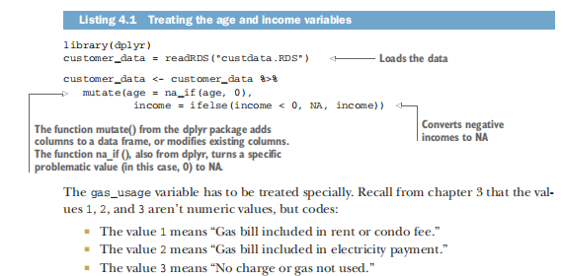

Slide 17
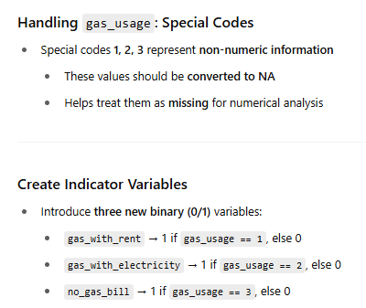

Slide 18
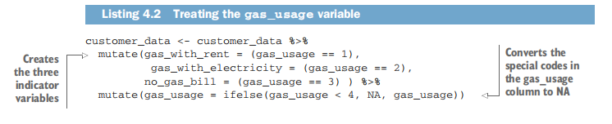
Code:

Slide 19
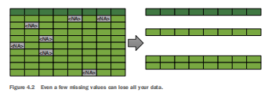
2. Treating Missing Values
General Strategies
Count missing values in each column to identify issues.
Three ways to handle missing values:
1. Drop rows with missing values.
2. Convert missing values to NA or meaningful values.
3. Use automated algorithms that handle missing data (e.g., in R or other tools).

Slide 20
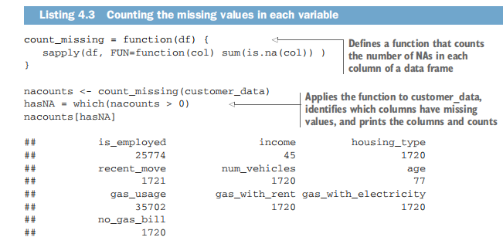

Slide 21
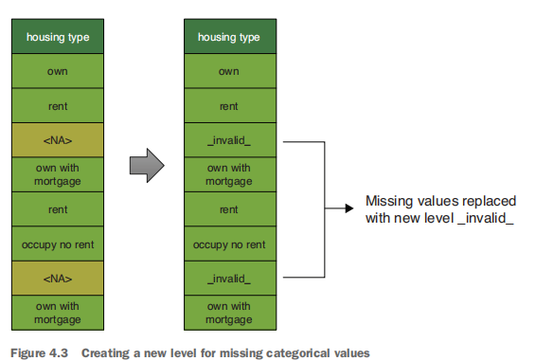
Handling Missing Categorical Values
Create a new level to represent missing category values.
Example: Replace missing values with a new level like "__invalid__" in variables such as housing_type.

Slide 22
Handling Missing Numeric or Logical Values
Example: income variable with many missing values.
Still important for prediction (e.g., health insurance coverage).
Possible Solutions:
1. Mean/Median imputation: Replace missing with average value.
2. Model-based estimation: Use other variables to predict missing values.
3. Statistical imputation: Replace with a reasonable estimate assuming missing at random.

Slide 23
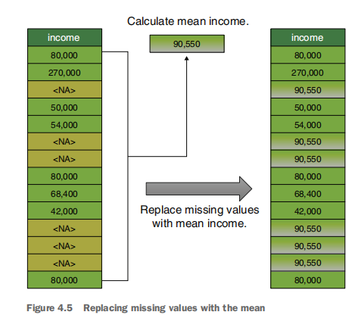
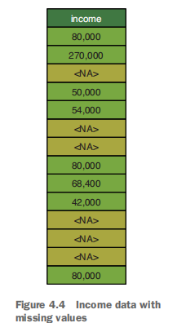

Slide 24
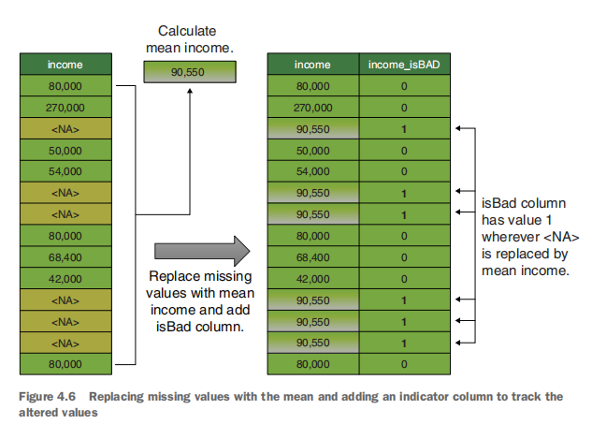
TREATING MISSING VALUES AS INFORMATION

Slide 25
3. The vtreat package for automatically treating missing variables
Missing values are very common in real-world data.
vtreat provides an automatic and repeatable way to handle them.
Ensures that data is “safe” for modeling:
1. No missing or unexpected values
2. Prevents data issues from harming model accuracy
Key Features of vtreat
Generates a treatment plan that:
1. Records averages for numeric variables (e.g., income)
2. Tracks all observed levels of categorical variables (e.g., housing_type)
Same treatment plan is used for:
1. Training data
2. New (test) data
Promotes consistent preprocessing

Slide 26
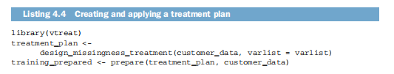
Basic vtreat Workflow:
1. Define input variables (exclude custid and target variable like health_ins)
2. Create a treatment plan
3. Use the plan to prepare both training and new datasets

Slide 27
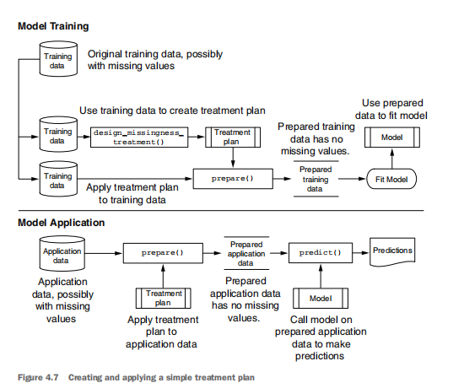

Slide 28
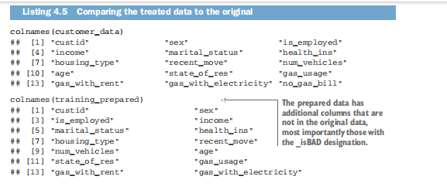
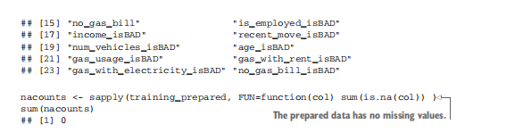

Slide 29
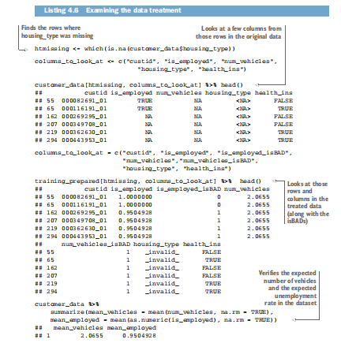

Slide 30
How vtreat Handles Missing Values:
🔹 Categorical Variables
Missing values are replaced with a new token:
→ _invalid_
(e.g., housing_type = NA becomes "_invalid_")
🔹 Numeric Variables
Missing values are replaced with the mean of that variable
(e.g., num_vehicles = NA → replaced with mean value)
🔹 Logical Variables
Converted to numeric (0/1) format
Missing values are replaced with the mean
(e.g., if is_employed = NA, replaced with average of non-missing values)

Slide 31
Beyond Missing Value Treatment
vtreat helps with more than missing values
Supports data transformations to address:
1. Invalid values
2. Categorical encoding
3. Inconsistent formats
4. These help make the data ready for modeling

Slide 32
Data Transformation
Use mutate to add new columns:
df %>% mutate(new = col1 + col2)
Use transmute to drop old columns.

Slide 33
Combining Data Frames
Use rbind() to bind rows, cbind() for columns.
Merge by common key:
merge(df1, df2, by='id')

Slide 34
Sampling for Modeling and Validation in R
Sampling is the process of selecting a subset of data from a full dataset for the purpose of training and evaluating models.
In predictive modeling, we usually split data into:
Training Set – to build the model
Testing Set – to evaluate the model's performance
Sometimes, a Validation Set is also used during model tuning.
sampling uses:
Prevents overfitting (model memorizing training data)
Helps evaluate generalization on unseen data
Allows cross-validation for more reliable metrics

Slide 35
Understanding Sampling in Data Science
What is Sampling?
Selecting a subset of the population to represent the whole.
Used in analysis, modeling, debugging, and visualization.
Why Sampling Still Matters in the Era of Big Data
Even “big data” is typically a sample from a larger universe.
Helps in:
1. Faster testing and debugging
2. Efficient visualizations (e.g., faster ggplot)
3. Avoiding overplotting that hides data patterns

Slide 36
Representativeness Matters
A sample should reflect the full population.
Example: Avoid using data from only one state (e.g., Connecticut) if your model is meant to serve all U.S. customers.
Geographic or demographic bias can lead to misleading predictions.
Other Uses of Sampling
Creating train-test splits for model evaluation.
Managing resource constraints during model development.

Slide 37
Sampling and Data Preparation 1. Test and Training Splits
Split dataset into:
1. Training Set → to fit the model
2. Test Set → to evaluate model performance
Optional: Calibration Set → for tuning model parameters

Slide 38
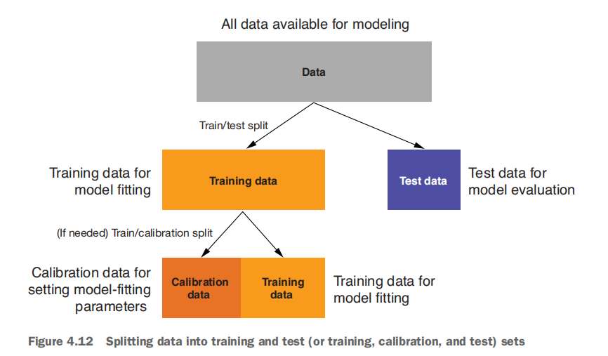

Slide 39
2. Creating a Sample Group Column
Use runif() to assign a random sample group number
Split data using a threshold (e.g., < 0.1) to create test and train sets
Enables reproducible sampling with set.seed()

Slide 40
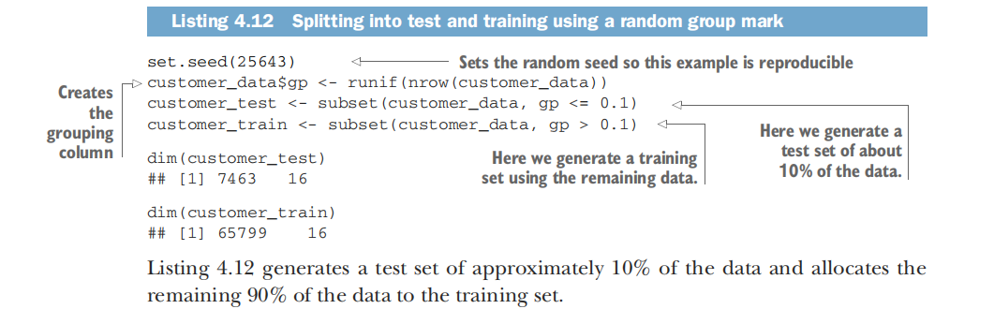

Slide 41
3. Record Grouping
Avoid splitting related records (e.g., members of the same household)
Assign the same group number to all members of a household
Helps maintain logical consistency during modeling

Slide 42
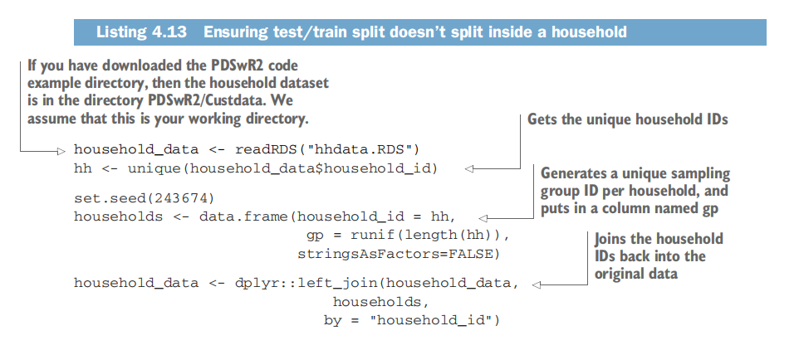

Slide 43
4. Data Provenance
Add metadata columns for:
1. Data source
2. Collection date
3. Treatment date
Helps track when and how data was prepared or updated
Useful for version control and model debugging

Slide 44
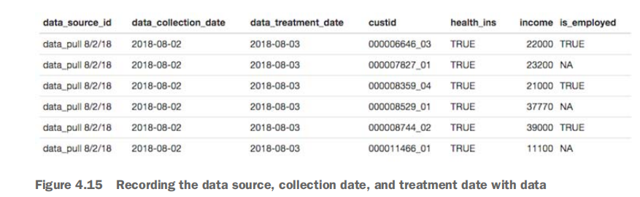

Slide 45
Common Sampling Techniques in R
1. Random Sampling using sample():
Input: data <- 1:100
sample(data, 10) # randomly selects 10 values
Output: [1] 34 67 12 78 92 11 3 55 80 25
2.Train-Test Split
Split your data into 70% training and 30% testing.

Slide 46
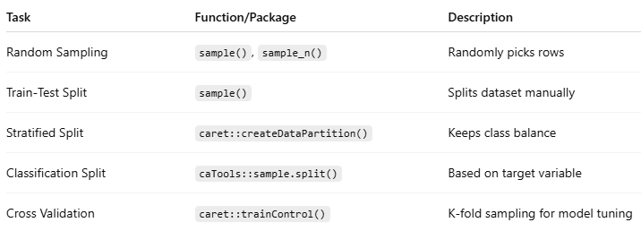

Slide 47
Sampling Data
Use sample():
sample(df$col, 5)
With dplyr:
sample_n(df, 5), sample_frac(df, 0.2)

Slide 48
Training/Test Split
Using index:
train <- df[1:70, ]; test <- df[71:100, ]
Or use sample.split() from caTools

Slide 49
Validation Sets
Use caret package:
createDataPartition(y, p=0.8, list=FALSE)
Helps in model validation

Slide 50
Data Summary with dplyr
Group and summarise:
df %>% group_by(col) %>% summarise(mean=mean(var), count=n())

Slide 51
NA Handling with tidyr
Drop NAs: drop_na()
Replace: replace_na()
Fill: fill(df, col, .direction='down')

Slide 52
Visualization Recap
Use hist(), boxplot(), ggplot()
Example:
ggplot(df, aes(x=col)) + geom_histogram()
Visual tools help identify patterns and issues quickly.

